Slide 1





Taiwan Day 2015 ^{08.11 @ TICC 1st Fl.}
Organized by
Sponsorship

Slide 2

Organized by
Sponsors
You

Slide 3


Who’s coming?
Position
7%
Senior
Manager
24%
Middle
Manager
20%
Junior
Manager
49%
Employee
Character in Datacenter Instruction
31%
User
58%
Influencers
7%
Decider
4%
Purchaser

Slide 4
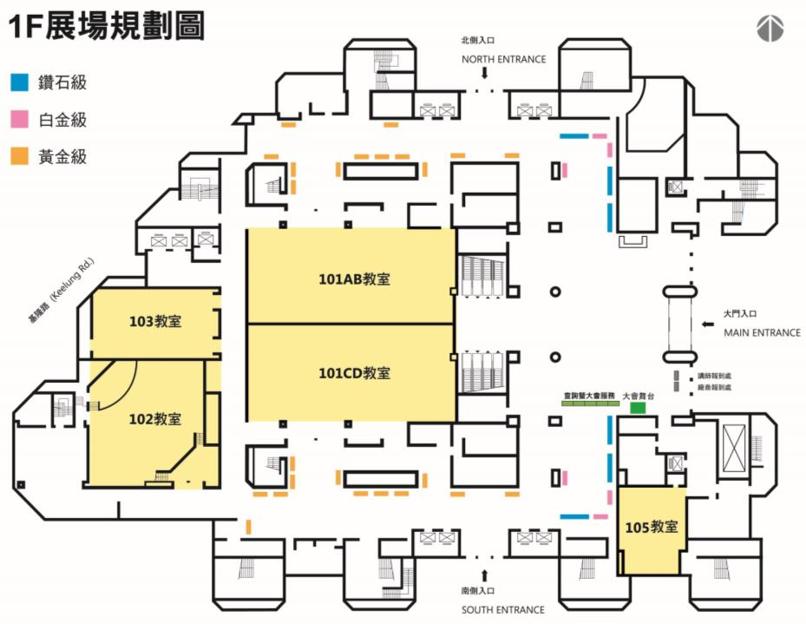
Floor Plan
(Provisional)
Diamond and Platinum booth
Conference
Room 101A
Room 101B
103
Conference
102
Conference
Room 101C
Room 101D
Registration
Side event

Slide 5
Progress
NOW
May
Jun
Jul
Aug
After
iThome | Sponsorship Invitation Start Proposal Agenda setting Floor planning | Advanced content setting Key visual design | Registration start | Registration | Registration Attending remind 8/11 OpenStack Taiwan Day 2015 | After report Slide download Speech video on-line
Sponsor |  | Contract signing Hand over sponsor information. | Co-promotion Hand over sponsor information. | Material proparation Draw for booth | Admission 8/11 OpenStack Taiwan Day 2015

Slide 6

Agenda & Sponsorship price
09:00~11:00 | Keynote ^{@ Plenary Hall}
 | 10:20~10:50 OpenStack Pioneer’s Sharing ( Diamond, 10 minutes *3） *Right for content suggestion reserved
11:00~11:30 | Break----------------------------- | ----------------------------------- | -----------------------------------
Tracks | A ^{@ TICC 1F Conference room} | B ^{@ TICC 1F Conference room} | C ^{@ TICC 1F Conference room}
11:30~12:10 | Diamond $250,000 | Diamond $250,000 | Diamond $250,000
12:10~13:40 | Lunch （2 hours）----------------- | & CIO Luncheon（TBD）---------- | --------------------------
13:40~14:20 | Platinum $160,000 | Platinum $160,000 | Platinum $160,000
14:20~14:30 | Break（10 mins）--------------------------- | ----------------------------------- | -----------------------------------
14:30~15:10 | Platinum $140,000 | Platinum $140,000 | Platinum $140,000
15:10~15:30 | Break（20 mins）--------------------------- | ----------------------------------- | -----------------------------------
15:30~16:10 | Golden $120,000 | Golden $120,000 | Golden $120,000
16:10~16:20 | Break（10 mins）--------------------------- | ----------------------------------- | -----------------------------------
16:20~17:00 | Golden $100,000 | Golden $100,000 | Golden $100,000
All Day Exhibition
Sliver
Booth only
$70,000
$NT, Tax excluded.

Slide 7
Sponsorships
 |  | Diamond Leading brand | Platinum Specific Leading | Gold High CP | Silver Economical
Key right | OpenStack Pioneer’s Sharing （Keynote 10 mins） | √
 | Breakout session（40 mins） | √ 鑽石時段 | √ 白金時段 | √ 黃金時段
 | Booth | √ Basic Booth *1 Draw-1st round | √ Basic Booth *1 Draw-2nd round | √ Basic Booth *1 Draw-2nd round | √ Basic Booth *1 Draw-2nd round
 | Session Attendee List （Only those who has authorized） | √ | √ | √
 | All Attendee List （Only those who has authorized） | √
Advertisement | Logo | As organizer | As co-organizer | As co-organizer | As sponsor
 | DM (in bag) | √ | √ | √ | √
 | Pre Coverage | ½ Page | ½Page | ¼ Page （Provided by sponsor）
 | Post Coverage | ½Page | ¼ Page | ¼Page
 | Speech trail (website) | √ | √ | √
 | Company intro (website) | √ | √ | √ | √
Remark | Please contact with iThome AE to reserve your preferred session. If there were other sponsors like to choose the same session with you, iThome AE will give you a notice via email. In that case, you will need to reply confirmation in 2 working days (48 hours) to keep the reservation, or cancel it automatically. Platinum sponsor can provide us more than one single logo, but only one of those could be listed as organizer, others will be listed as co-organizer.

Slide 8
Taiwan Day 2015 ^{08.11 @ TICC 1st Fl.}
透過贊助本次盛會，您將獲得絕佳的宣傳推廣機會，在眾多相關廠商面前展示您的企業形象、享受獨家曝光，並能主動接觸到各層產業的潛在客戶，藉此拓展您的市場版圖以及增加商機。
Organized by
Promotion

Slide 9




Media Plan
Reminder phone call
Reminder
e-mail
Reminder Text
Onsite Registration
Refuse
FAKE
Attendees Recruitment
eDM
Online AD
AD page
Invitation Letter
For better event quality, iThome will integrate all the promotion resources and verify the online registration.

Slide 10
Media Plan
8-week-promotion will bring you the greatest media effect.
Event promotion will kick off in APR. 2015.
  iThome Online
  iThome e-paper、member eDM
  AD page on iThome Weekly
  Invitation via individual industry database
  Event Website：Keep the “Navigation to CDE”updated on the website continuously.
Additional promotional tool -“Navigation to CDE”
Diamond level sponsor – Advertorial interviewed, written and edited by iThome
Gold level sponsor – Provided by sponsor.

Slide 11
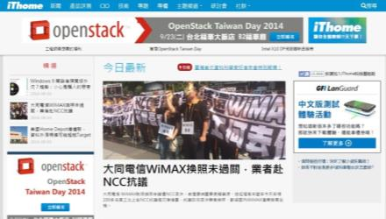
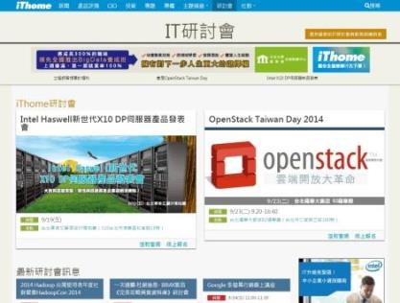
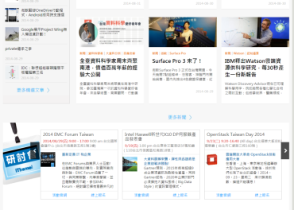
iThome Online

Slide 12
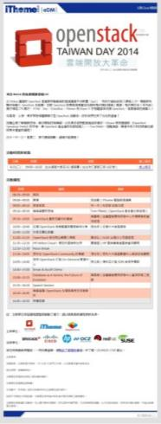

iThome ePaper &edm

Slide 13
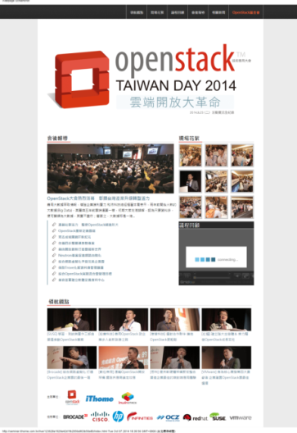
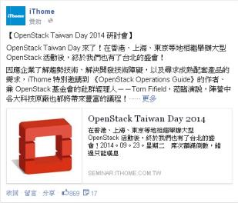
Event site and Facebook promotion

Slide 14

Published advertisement

Slide 15
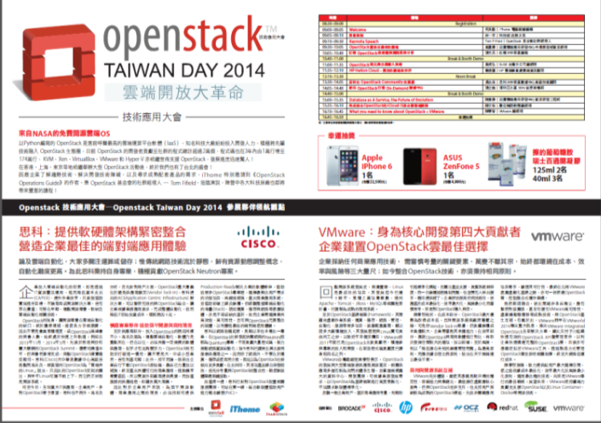
Sample of Navigation to CDE

Slide 16
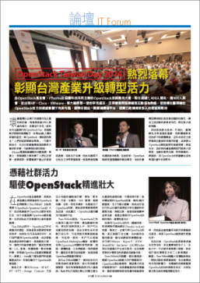
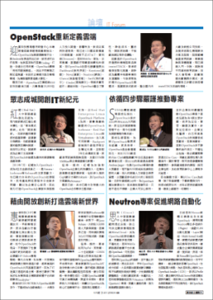
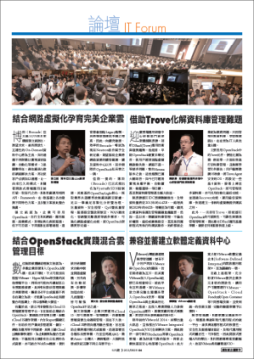
After Report

Slide 17
Continuous Related News
不落人後！臺灣OpenStack Day技術大會9月23日登場
臺灣首次OpenStack Day技術大會登場，官方專家來臺揭露最新進展
Docker當紅，取得4000萬美元新資金！
HP 收購Eucalyptus，MySQL前執行長Marten Mickos將主掌雲端業務
中華電信以OpenStack發展SDN
擁抱開源OpenStack和Docker，VMware跨出私有雲邁向混合雲策略
VMware發表自家的OpenStack版本
OpenStack開源新勢力能否撼動VMware帝國？
在臺率先成立OpenStack顧問團隊 惠普砸重金要靠Helion大翻身
OpenStack臺灣先期投入者：硬體價值削弱得靠服務競爭
OpenStack基金會社群經理揭露OpenStack新版關鍵特色
挑戰雙V雲端版圖 OpenStack逐漸成氣候
Gartner看OpenStack：周邊工具不足且部署門檻高
紅帽大中華區總裁張先民：雲端服務採用開源軟體勢在必行
戴爾將和紅帽合推OpenStack整合產品

Slide 18
Taiwan Day 2014
Organized by
Review

Slide 19
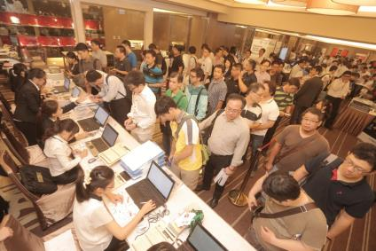
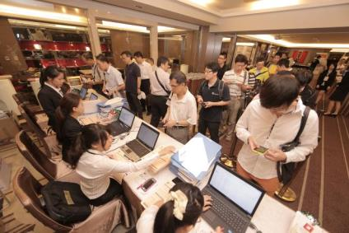
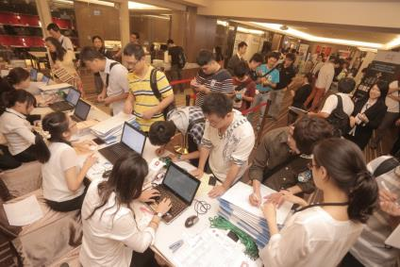
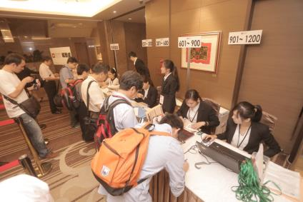
Registration

Slide 20
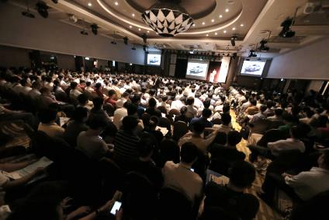
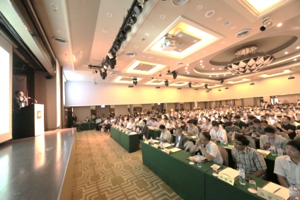
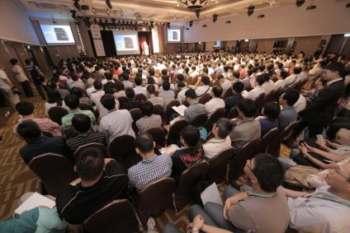
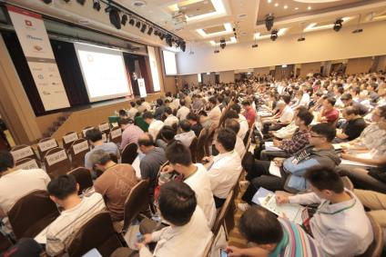
Conference

Slide 21
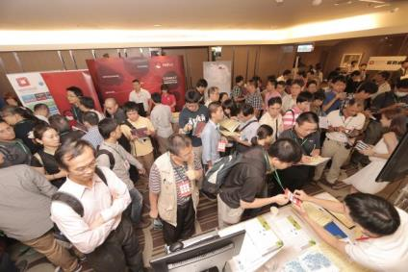
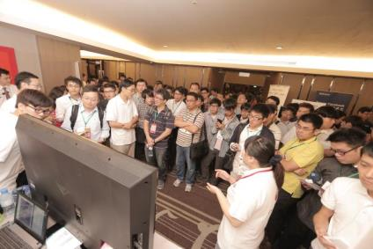
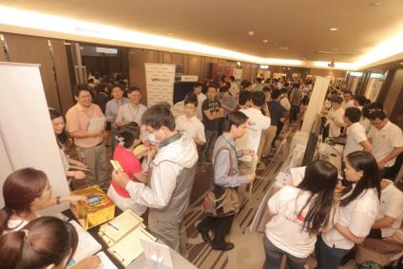
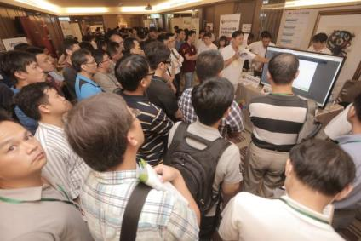
Break and Booth

Slide 22
Taiwan Day 2015 ^{08.11 @ TICC 1st Fl.}
Organized by

