Slide 2
Elections – Which Elections?
The Election Processes:
The OpenStack Foundation has 3
Technical leadership of PTL’s – Process set by technical community
Platinum Member-Appointed by Members-8 slots
Gold Member – Director Elections – 8 Slots
Individual Director Elections – 8 Slots
The board is reviewing how Individual Directors are Elected
Dramatic growth of community
Desire for diverse representation
Inspire the community to participate

Slide 3
Elections – So just pick a system and get on with it
Turns out we need to proceed but with care
The Foundation is a Delaware Non-Stock Corporation and need to comply with Delaware corporate law (the TC is not a Board committee and does not need to comply with Delaware law)
Delaware corporate law recognizes two systems: single vote system (i.e. one vote for each director) with cumulative voting as an option
Delaware corporate law provides for flexibility if not “otherwise prohibited”
Individual Member Director Elections use the cumulative voting option
Allows members to use eight votes for one candidate
Votes for a candidate can be “wasted”
Our membership argues on both sides of this equation with some wanting to preserve the current system and others that want to change it.
Risk of mistake: Adopting a system that is not permissible under Delaware corporate law, those directors will not be properly elected and thus
Their votes at the Board meetings will not count
Board actions may not be effective because these votes don’t count

Slide 4
Corporate Governance Cautions
Proposed Options:
Condorcet
Single Transferable Vote
Both systems have numerous options and need to pick an option
Current proposals are in gray area of Delaware corporate law and experts have very different opinions about enforceability
Minimum requirement: the system must be explained in sufficient detail and “simplicity” so a Delaware judge could understand it and “enforce” compliance
Adoption is not simple: modifying bylaws to change this vote is part of “protected provisions” with special approval requirements:
Two thirds of Board
Majority of Individual Members voting with a minimum of 25% of Individual Members voting
Note: Other coordinating changes could require special votes of Platinum and Gold Members
Effective only prospectively: an approval at the 2014 Annual meeting (January 2014 vote) would take effect in the 2015 Board elections

Slide 5
So How will we figure this out?
The Process:
Come up with options and understand the legal constraints
Analyze the available options
Keep or Modify the current system
Find an alternative that is preferred by the membership and may meet legal requirements
Single transferrable Vote
Condorcet
Inform the membership and seek feedback
Present an option to the board this month for vote
If a change - proposed system to be voted on in the January election cycle for use in later cycles
Option must be plain language describable
We are here

Slide 6
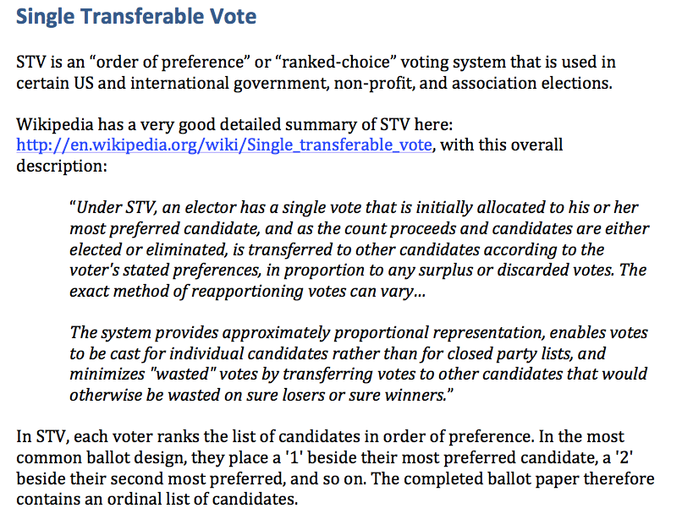
Single Transferrable Vote

Slide 7
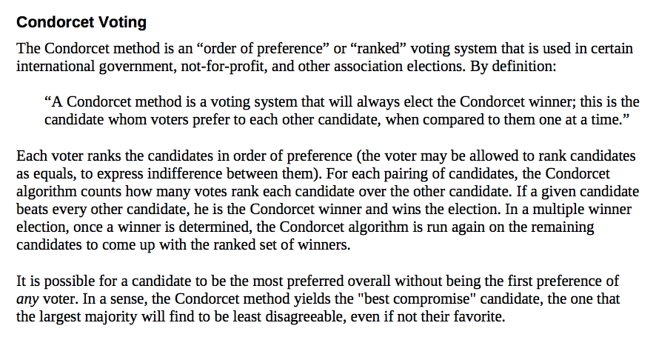
Condorcet

Slide 8
Your thoughts?
Questions and Feedback – Microphones are open
Or
Email to the mailing list:
elections-committee@lists.openstack.org

